Slide 1
12V UPS
-By Sonali Nautiyal

Slide 2
Block Diagram
5V
LiPo Battery
TRIG
LM7805
TP4056
Relay
12V Boost Converter
12V
5V
3.7V
Load
12V

Slide 3
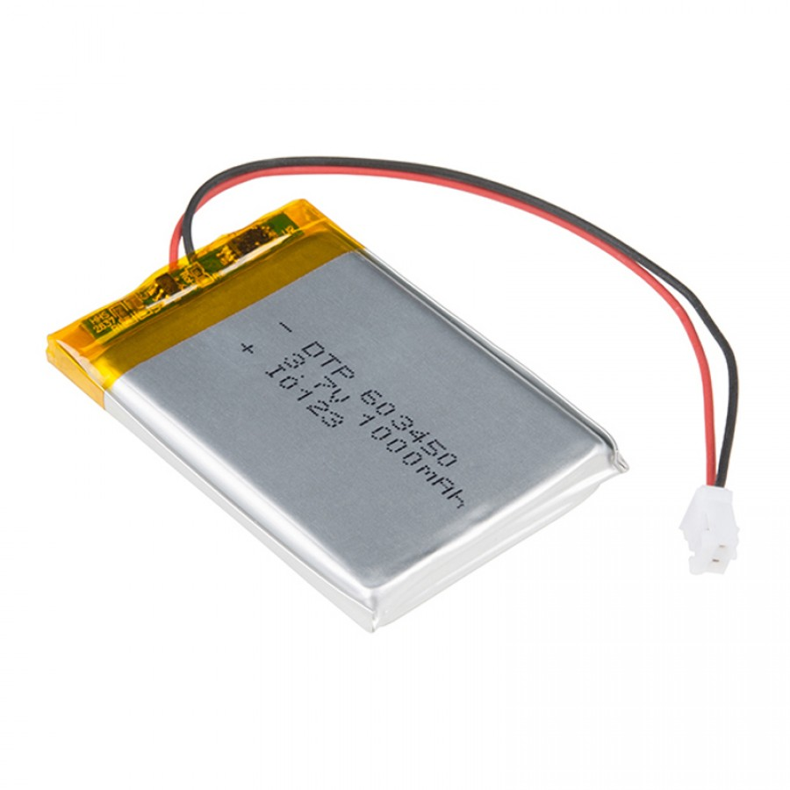
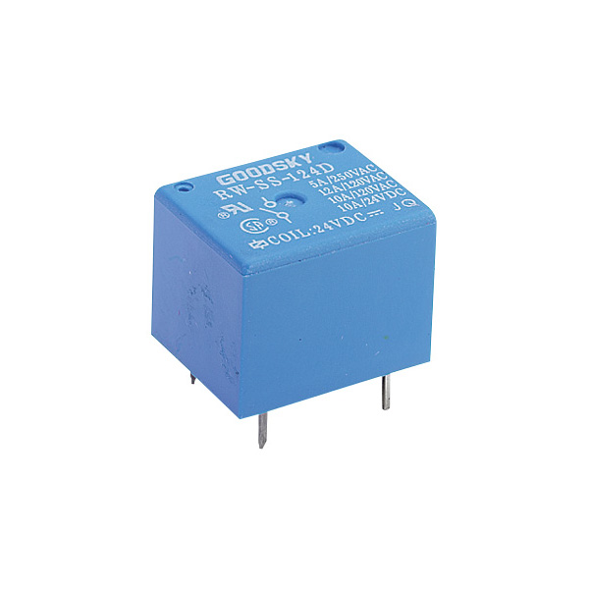
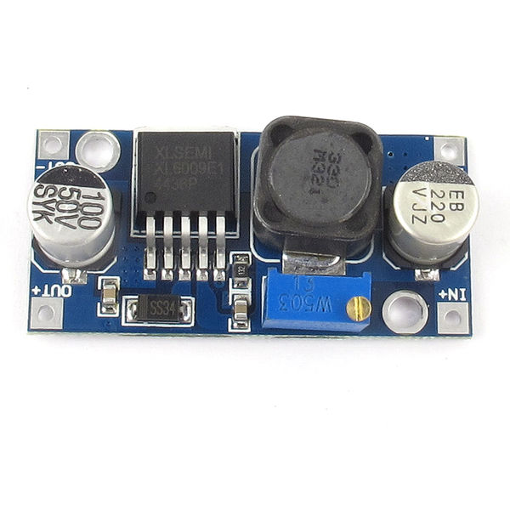
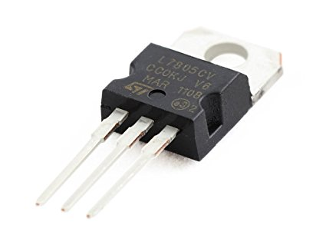
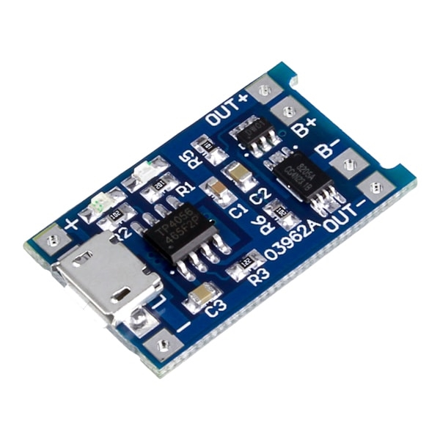
Block Diagram
5V
SW
12V
5V
3.7V
Load
12V

Slide 4
Block Diagram – During Power-cut
0V
LiPo Battery
Discharging
TRIG
LM7805
TP4056
Relay
12V Boost Converter
0V
0V
3.7V
3.7V
12V Load
X
0V

Slide 5
Block Diagram – During normal condition
5V
LiPo Battery
Charging
TRIG
LM7805
TP4056
Relay
12V Boost Converter
12V
5V
3.7V
X
12V
12V Load
12V

Slide 6
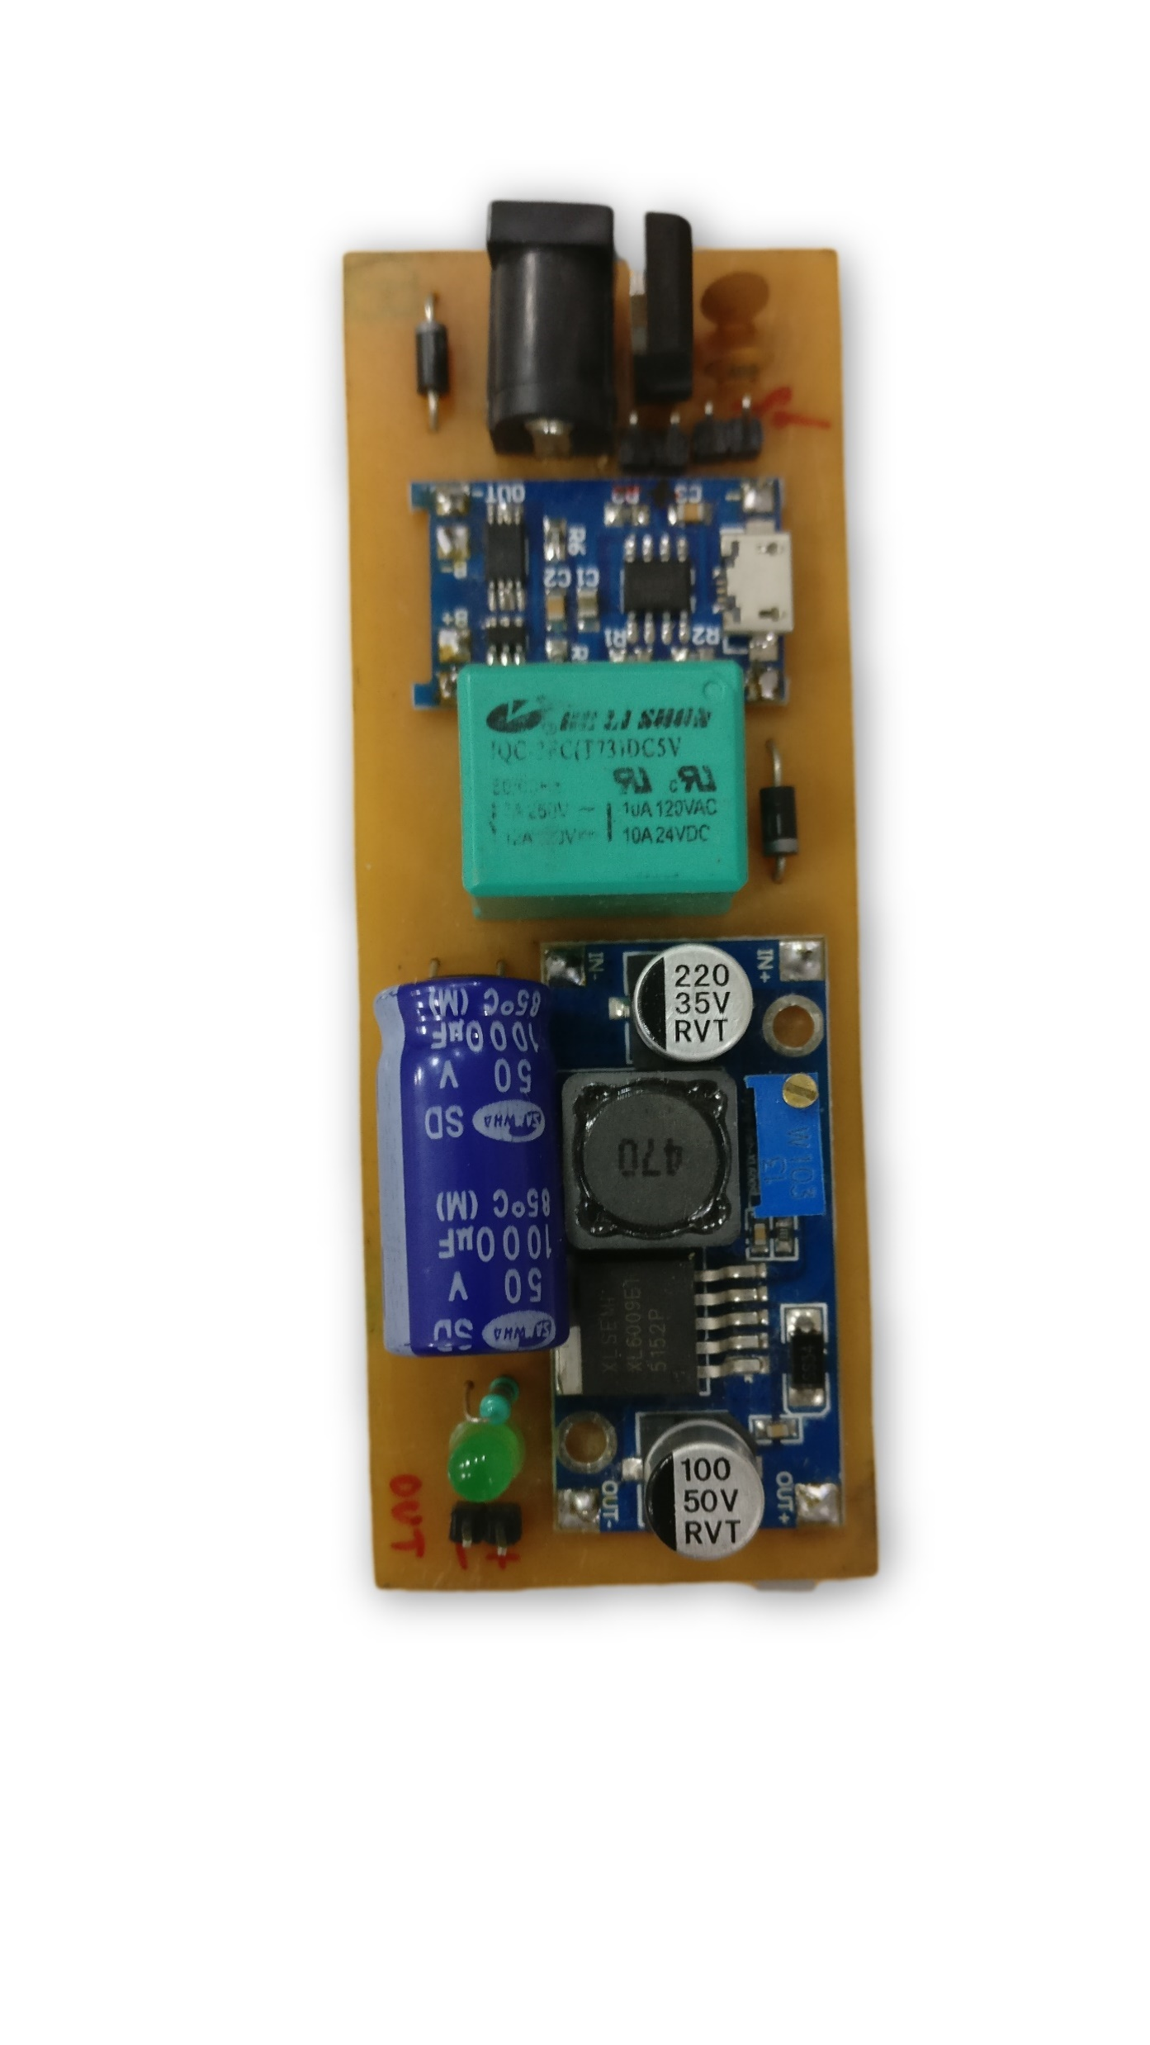
Board
Battery +
Relay
Boost Converter
Battery -
LM7805
12V
+
12V Load
-
TP4056
LPF Capacitor

